Slide 1
Implementing CDC Guidelines in Texas
Catherine Eppes, MD
Baylor College of Medicine | Co-chair, TCHMB Data Subcommittee
Manda Hall, MD
Department of State Health Services

Slide 2
Objectives
Provide a highlight of current CDC guidelines for testing and management of pregnant women at risk of Zika
Provide a highlight of current DSHS guidelines for testing pregnant women in South Texas
Provide a highlight of current CDC guidelines for testing and management of newborns of mothers with potential exposure to Zika

Slide 3
Zika Virus Laboratory Testing for Pregnant Women
Which pregnant women should be tested for Zika virus?
Pregnant women with either:
A personal history of recent travel to or residence in an area with risk of Zika during pregnancy or the periconceptional period
Unprotected sex or sexual contact without a condom during pregnancy with a person who traveled to or lives in an area with risk of Zika
Screen all pregnant women at each prenatal visit
https://www.cdc.gov/pregnancy/zika/index.html

Slide 4
CDC Screening Tool
https://www.cdc.gov/pregnancy/zika/testing-follow-up/documents/ZikaPreg_ScreeningTool.pdf

Slide 5
Zika Virus Laboratory Testing for Pregnant Women
Laboratory testing for Zika virus has a number of limitations:
Zika virus RNA is only transiently present in body fluids; negative nucleic acid testing (NAT) does not rule out infection.
Serologic testing is affected by timing of sample collection: a negative immunoglobulin M (IgM) serologic test result does not rule out infection because the serum specimen might collect before the development of IgM antibodies, or after these antibodies wane.
Conversely, IgM antibod­ies might be detectable for months after the initial infection; for pregnant women, this can make it difficult to determine if infection occurred before or during a current pregnancy.
Cross-reactivity of the Zika virus IgM antibody tests with other flaviviruses can result in false-positive test result.

Slide 6
Update: Interim Guidance for Health Care Providers Caring for Pregnant Women with Possible Zika Virus Exposure — United States (Including U.S. Territories), July 2017
CDC has updated the interim guidance in response to:
declining prevalence of Zika virus disease
emerging evidence indicating prolonged detection of Zika virus immunoglobulin M (IgM) antibodies
Oduyebo T, Polen KD, Walke HT, et al. Update: Interim Guidance for Health Care Providers Caring for Pregnant Women with Possible Zika Virus Exposure — United States (Including U.S. Territories), July 2017. MMWR Morb Mortal Wkly Rep 2017;66:781-793. DOI: http://dx.doi.org/10.15585/mmwr.mm6629e1.

Slide 7
Update: Interim Guidance for Health Care Providers Caring for Pregnant Women with Possible Zika Virus Exposure — United States (Including U.S. Territories), July 2017
The guidance emphasizes a shared decision-making model for testing and screening pregnant women
Oduyebo et. al.

Slide 8
Update: Interim Guidance for Health Care Providers Caring for Pregnant Women with Possible Zika Virus Exposure — United States (Including U.S. Territories), July 2017
Key recommendations include the following:
All pregnant women in the United States and U.S. territories should be asked about possible Zika virus exposure before and during the current pregnancy, at every prenatal care visit
Pregnant women with recent possible Zika virus exposure and symptoms†of Zika virus disease should be tested to diagnose the cause of their symptoms
Asymptomatic pregnant women with ongoing possible Zika virus exposure§should be offered Zika virus NAT testing three times during pregnancy
Asymptomatic pregnant women who have recent¶ possible Zika virus exposure (i.e., through travel or sexual exposure) but without ongoing possible exposure are not routinely recommended to have Zika virus testing
Oduyebo et. al.

Slide 9
Update: Interim Guidance for Health Care Providers Caring for Pregnant Women with Possible Zika Virus Exposure — United States (Including U.S. Territories), July 2017
Key recommendations include the following:
Pregnant women who have recent possible Zika virus exposure and who have a fetus with prenatal ultrasound findings consistent with congenital Zika virus syndrome should receive Zika virus testing to assist in establishing the etiology of the birth defects
The comprehensive approach to testing placental and fetal tissues has been updated
Zika virus IgM testing as part of preconception counseling to establish baseline IgM results for nonpregnant women with ongoing possible Zika virus exposure is not warranted
Oduyebo et. al.

Slide 10
Prenatal Management of Pregnant Women with Laboratory Evidence of Zika
The CDC recommends the following prenatal services for pregnant women with laboratory evidence of possible Zika virus infection:
Consider serial fetal ultrasounds (every 3–4 weeks) to assess fetal anatomy, particularly fetal neuroanatomy, and to monitor growth.
Evaluate fetal anatomy (particularly neuroanatomy) through prenatal ultrasounds to identify brain or structural abnormalities that might occur before microcephaly.
Individualize decisions about performing amniocentesis as there is a paucity of data regarding the usefulness of amniocentesis in diagnosing congenital Zika virus infection.
Oduyebo et. al.

Slide 11
Testing Pregnant Women in South Texas
DSHS Health Alert, August 24, 2017
Test symptomatic pregnant women in the following counties regardless of travel or sexual exposure history:
Cameron
Hidalgo
Kinney*
Maverick*
Starr
Val Verde*
Webb
Willacy
Zapata

Slide 12
Testing Pregnant Women in South Texas
DSHS Health Alert, August 24, 2017
Test asymptomatic pregnant women in the following counties three times during pregnancy using both PCR and IgM concurrently:
Cameron
Hidalgo
Kinney*
Maverick*
Starr
Val Verde*
Webb
Willacy
Zapata

Slide 13
Testing Pregnant Women in South Texas
DSHS Health Alert, August 24, 2017
Test non-pregnant women in the following counties who exhibit a rash and at least one other common Zika symptom (fever, joint pain, or conjunctivitis):
Cameron
Hidalgo
Kinney*
Maverick*
Starr
Val Verde*
Webb
Willacy
Zapata

Slide 14
Revised Statewide Testing Guidelines
DSHS Health Alert, August 24, 2017
For all symptomatic individuals who meet testing criteria: test as soon as possible up to 12 weeks after onset using both PCR and IgM concurrently*
For all asymptomatic pregnant women who meet testing criteria: test as soon as possible up to 12 weeks after exposure using both PCR and IgM concurrently*

Slide 15
Update: Interim Guidance for the Diagnosis, Evaluation, and Management of Infants with Possible Congenital Zika Virus Infection — United States, October 2017
three clinical scenarios in the setting of possible maternal Zika virus exposure:
infants with clinical findings consistent with congenital Zika syndrome regardless of maternal testing results
infants without clinical findings consistent with congenital Zika syndrome who were born to mothers with laboratory evidence of possible Zika virus infection,† and
infants without clinical findings consistent with congenital Zika syndrome who were born to mothers without laboratory evidence of possible Zika virus infection.
Adebanjo T, Godfred-Cato S, Viens L, et al. Update: Interim Guidance for the Diagnosis, Evaluation, and Management of Infants with Possible Congenital Zika Virus Infection — United States, October 2017. MMWR Morb Mortal Wkly Rep 2017;66:1089–1099. DOI: http://dx.doi.org/10.15585/mmwr.mm6641a1.

Slide 16
Congenital Zika Syndrome
Severe microcephaly in which the skull has partially collapsed
Decreased brain tissue with a specific pattern of brain damage, including subcortical calcifications
Damage to the back of the eye, including macular scarring and focal pigmentary retinal mottling
Congenital contractures, such as clubfoot or arthrogryposis
Hypertonia restricting body movement soon after birth
https://www.cdc.gov/pregnancy/zika/testing-follow-up/zika-syndrome-birth-defects.html

Slide 17
Laboratory Testing of Newborns born to Mothers with Potential Exposure to Zika
The CDC recommends laboratory testing for:
Infants with clinical findings consistent with congenital Zika syndrome and possible maternal Zika virus exposure during pregnancy, regardless of maternal testing results.
Infants without clinical findings consistent with congenital Zika syndrome born to mothers with laboratory evidence of possible Zika virus infection during pregnancy.
Adebanjo et al

Slide 18
Laboratory Testing of Newborns born to Mothers with Potential Exposure to Zika
Laboratory testing should include:
Zika virus RNA in infant serum and urine and Zika virus IgM antibodies in serum
If cerebrospinal fluid (CSF) is obtained for other purposes, NAT and IgM antibody testing should be performed on CSF
Testing of cord blood is not recommended because it can yield false-positive and false-negative test results
Adebanjo et al

Slide 19
Infant test result* |  | Interpretation
NAT | IgM
Positive | Any result | Confirmed congenital Zika virus infection†
Negative | Nonnegative | Probable congenital Zika virus infection§,¶
Negative | Negative | Congenital Zika virus infection unlikely§,**
TABLE. Interpretation of results of laboratory testing of infant’s blood, urine, and/or cerebrospinal fluid for evidence of congenital Zika virus infection
Adebanjo T, Godfred-Cato S, Viens L, et al. Update: Interim Guidance for the Diagnosis, Evaluation, and Management of Infants with Possible Congenital Zika Virus Infection — United States, October 2017. MMWR Morb Mortal Wkly Rep 2017;66:1089–1099. DOI: http://dx.doi.org/10.15585/mmwr.mm6641a1.

Slide 20
Testing Newborns of Mothers with Potential Exposure to Zika
Laboratory testing is not routinely recommended for infants without Clinical Findings Consistent with Congenital Zika Syndrome Born to Mothers with Possible Zika Virus Exposure in Pregnancy but without Laboratory Evidence of Possible Zika Virus Infection During Pregnancy
Adebanjo et al

Slide 21
Standard evaluation recommended at birth and during each well visit for all infants with possible congenital Zika virus exposure during pregnancy — United States, October 2017
Comprehensive physical exam, including growth parameters
Developmental monitoring and screening using validated screening tools recommended by the American Academy of Pediatrics (https://www.aap.org/en-us/advocacy-and-policy/aap-health-initiatives/Screening/Pages/Screening-Tools.aspx)
Vision screening as recommended by the American Academy of Pediatrics Policy Statement “Visual System Assessment in Infants, Children, and Young Adults by Pediatricians” (http://pediatrics.aappublications.org/content/137/1/e20153596)
Newborn hearing screen at birth, preferably with automated auditory brainstem response
Adebanjo et al

Slide 22
Evaluation and Management of Infants with Clinical Findings consistent with Congenital Zika Virus Syndrome
Head ultrasound by age 1 month
Comprehensive ophthalmologic exam by age 1 month
ABR response by age 1 month if the newborn hearing screening was passed using only otoacoustic emissions methodology
Refer to developmental specialist and early intervention
Connect to family support services
Also consider consultations with:
Infectious disease
Clinical genetics
Neurology by age 1 month
Other clinical specialists based on the infant’s clinical findings
Adebanjo et al

Slide 23
Evaluation and Management of Infants with Clinical Findings consistent with Congenital Zika Virus Syndrome
follow-up care through multidisciplinary team and an established medical home
Well-child visits should include a standard evaluation, and routine preventive pediatric care and immunizations
Follow-up visits with an ophthalmologist after the initial eye examination should be based on ophthalmology recommendations.
a diagnostic ABR is no longer recommended at age 4–6 months for infants who passed the initial hearing screen with automated ABR
Additional follow-up will depend on clinical findings in the infant.
Adebanjo et al

Slide 24
Evaluation and Management of Infants without Clinical Findings consistent with Congenital Zika Syndrome and with Laboratory Evidence of Zika Virus Infection
Head ultrasound by age 1 month
Comprehensive ophthalmologic exam by age 1 month
Refer for automated ABR by age 1 month if newborn hearing screen was passed using only otoacoustic emissions methodology.
At each subsequent well-child visit, be vigilant for signs that might be associated with Zika.
If findings are identified, refer to appropriate specialists and follow recommendations for infants with clinical findings.
Well-child visits should include a standard evaluation along with routine preventive pediatric care and immunizations
Adebanjo et al

Slide 25
Evaluation and Management of Infants without Clinical Findings consistent with Congenital Zika Syndrome born to mothers without laboratory evidence of possible Zika virus infection during pregnancy
Standard evaluation at birth and at subsequent well child visits
Routine preventive pediatric care and immunizations
Further evaluation is not typically warranted
If findings are identified, referrals to appropriate specialists should be made and subsequent evaluation should follow recommendations for infants with clinical findings consistent with congenital Zika syndrome

Slide 26
Management of Newborns of Mothers with Potential Exposure to Zika
All women with Zika virus infection during pregnancy should be encouraged and supported to breastfeed their infants, regardless of infant Zika virus testing results.
Adebanjo et al

Slide 27
Health care providers should remain alert for abnormal findings (e.g., postnatal-onset microcephaly and eye abnormalities without microcephaly) in infants with possible congenital Zika virus exposure without apparent abnormalities at birth.
Adebanjo et al

Slide 29
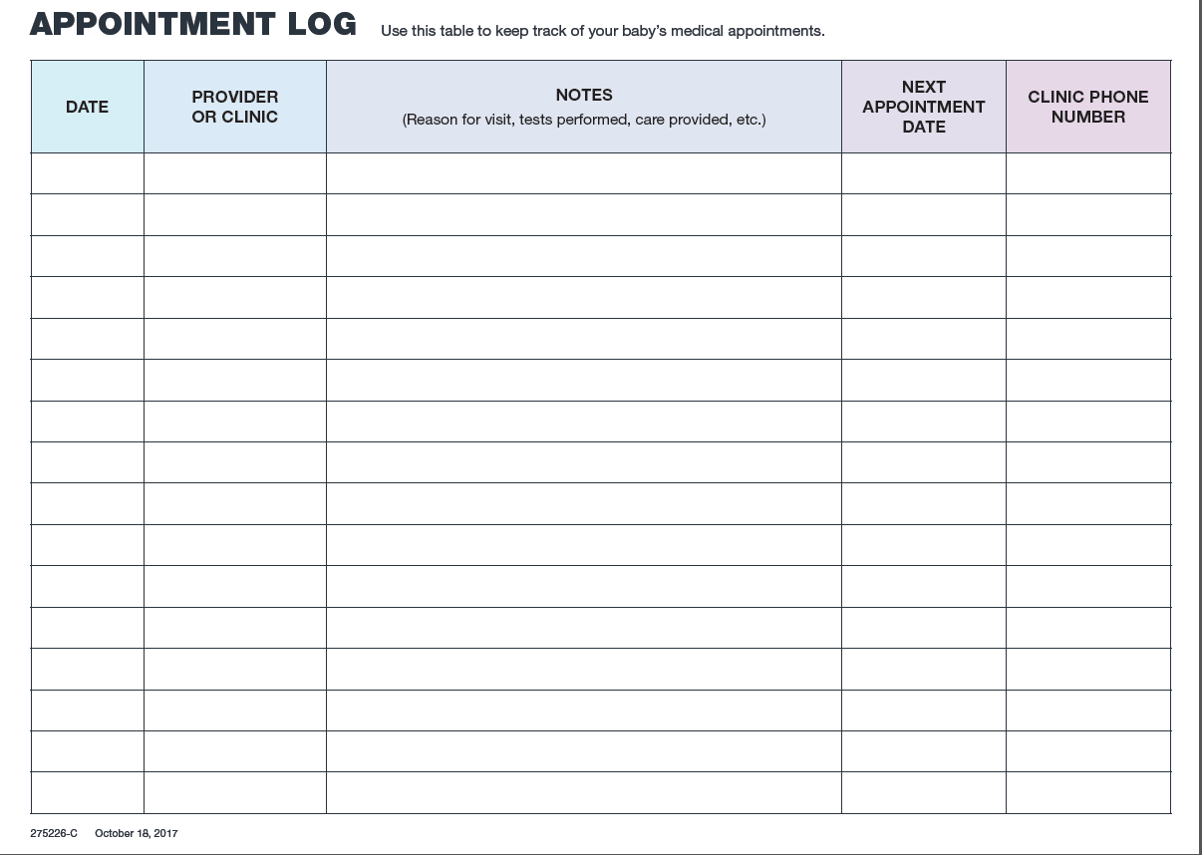

Slide 30
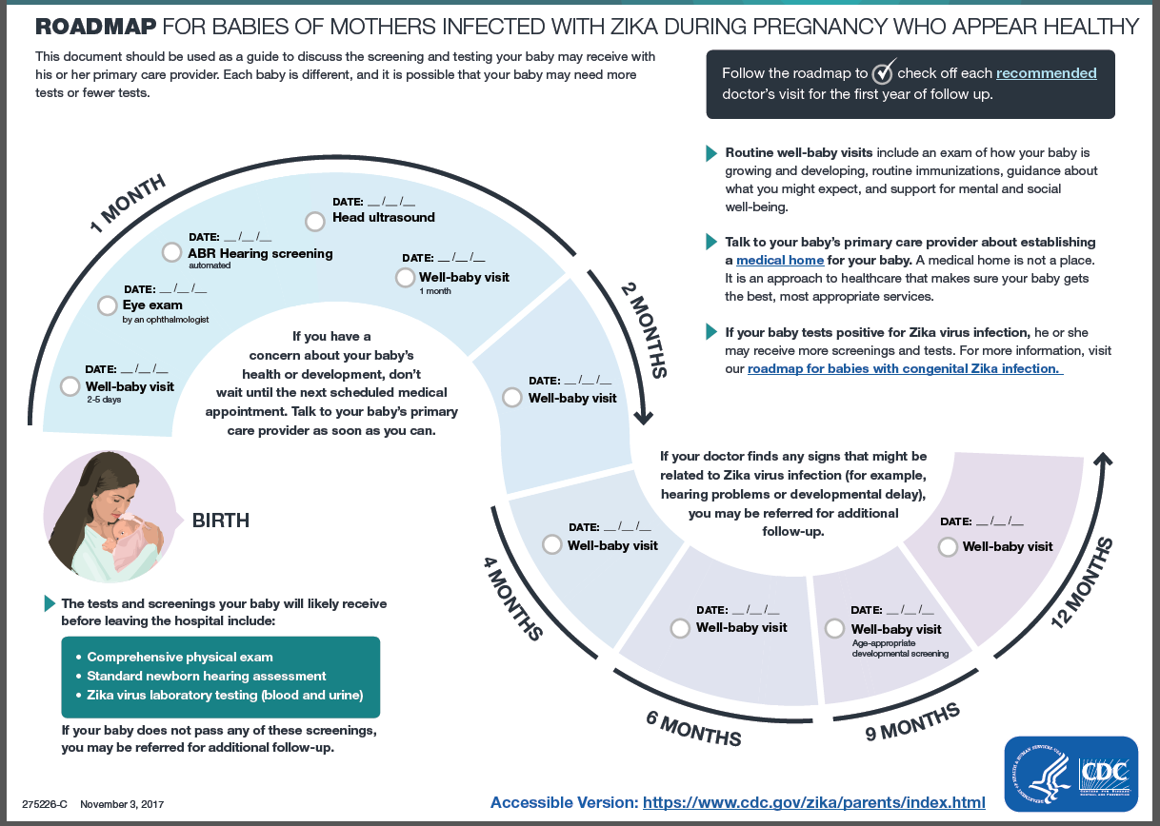

Slide 32
References
Adebanjo T, Godfred-Cato S, Viens L, et al. Update: Interim Guidance for the Diagnosis, Evaluation, and Management of Infants with Possible Congenital Zika Virus Infection — United States, October 2017. MMWR Morb Mortal Wkly Rep 2017;66:1089–1099. DOI: http://dx.doi.org/10.15585/mmwr.mm6641a1.
DSHS Health Alert, August 24, 2017
Oduyebo T, Polen KD, Walke HT, et al. Update: Interim Guidance for Health Care Providers Caring for Pregnant Women with Possible Zika Virus Exposure — United States (Including U.S. Territories), July 2017. MMWR Morb Mortal Wkly Rep 2017;66:781-793. DOI: http://dx.doi.org/10.15585/mmwr.mm6629e1.

Slide 33
Thank you

