Slide 1
David Lakey, M.D.
Vice Chancellor for Health Affairs and Chief Medical Officer
The University of Texas System
January 29, 2019
Notes:
Good morning, everyone. My name is Ella Puga, and I’m here to talk to you about the Texas Collaborative for Healthy Mothers and Babies

Slide 2
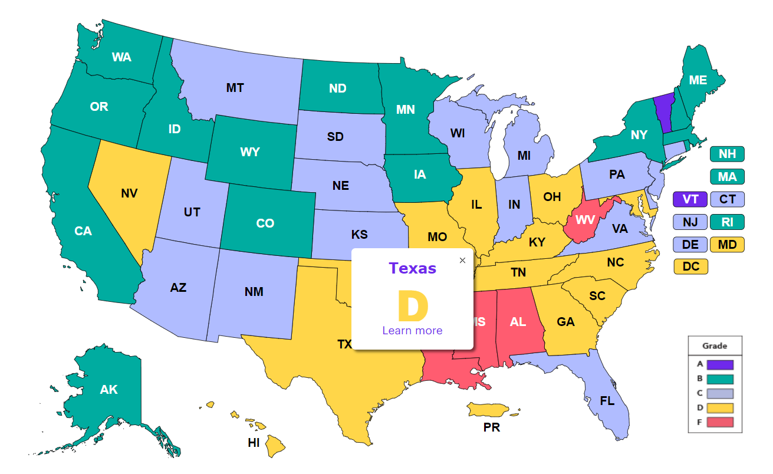
2018 Premature Birth Report Cards
Notes:
Preterm birth is another persistent public health issue in the US. According to the March of Dimes, in 2015, CDC NCHS data for the country showed that the preterm birth rate increased, and I quote: “amidst widening differences in prematurity rates across different races and ethnicities.”

Slide 3
TCHMB - Timeline
November 2013
HTB Expert Panel transitioned to become the Texas Collaborative for Healthy Mothers and Babies (TCHMB).
TCHMB, coordinated and facilitated by DSHS, grew to approximately 150 members.
November 2015
UT Health Science Center at Tyler, in partnership with UT System, began providing support to the TCHMB through a three year contract with DSHS.
November 2018
Contract with DSHS, Title V & Maternal and Child Health, is renewed through fiscal year 2021
Notes:
Three years after the HTB initiative started, its leaders decided to transform the HTB Expert Panel into a state perinatal quality collaborative for Texas. Thus TCHMB was born.
Two years after that, DSHS then contracted with UT to support TCHMB.

Slide 4
Notes:
The vision of TCHMB is that:

Slide 5
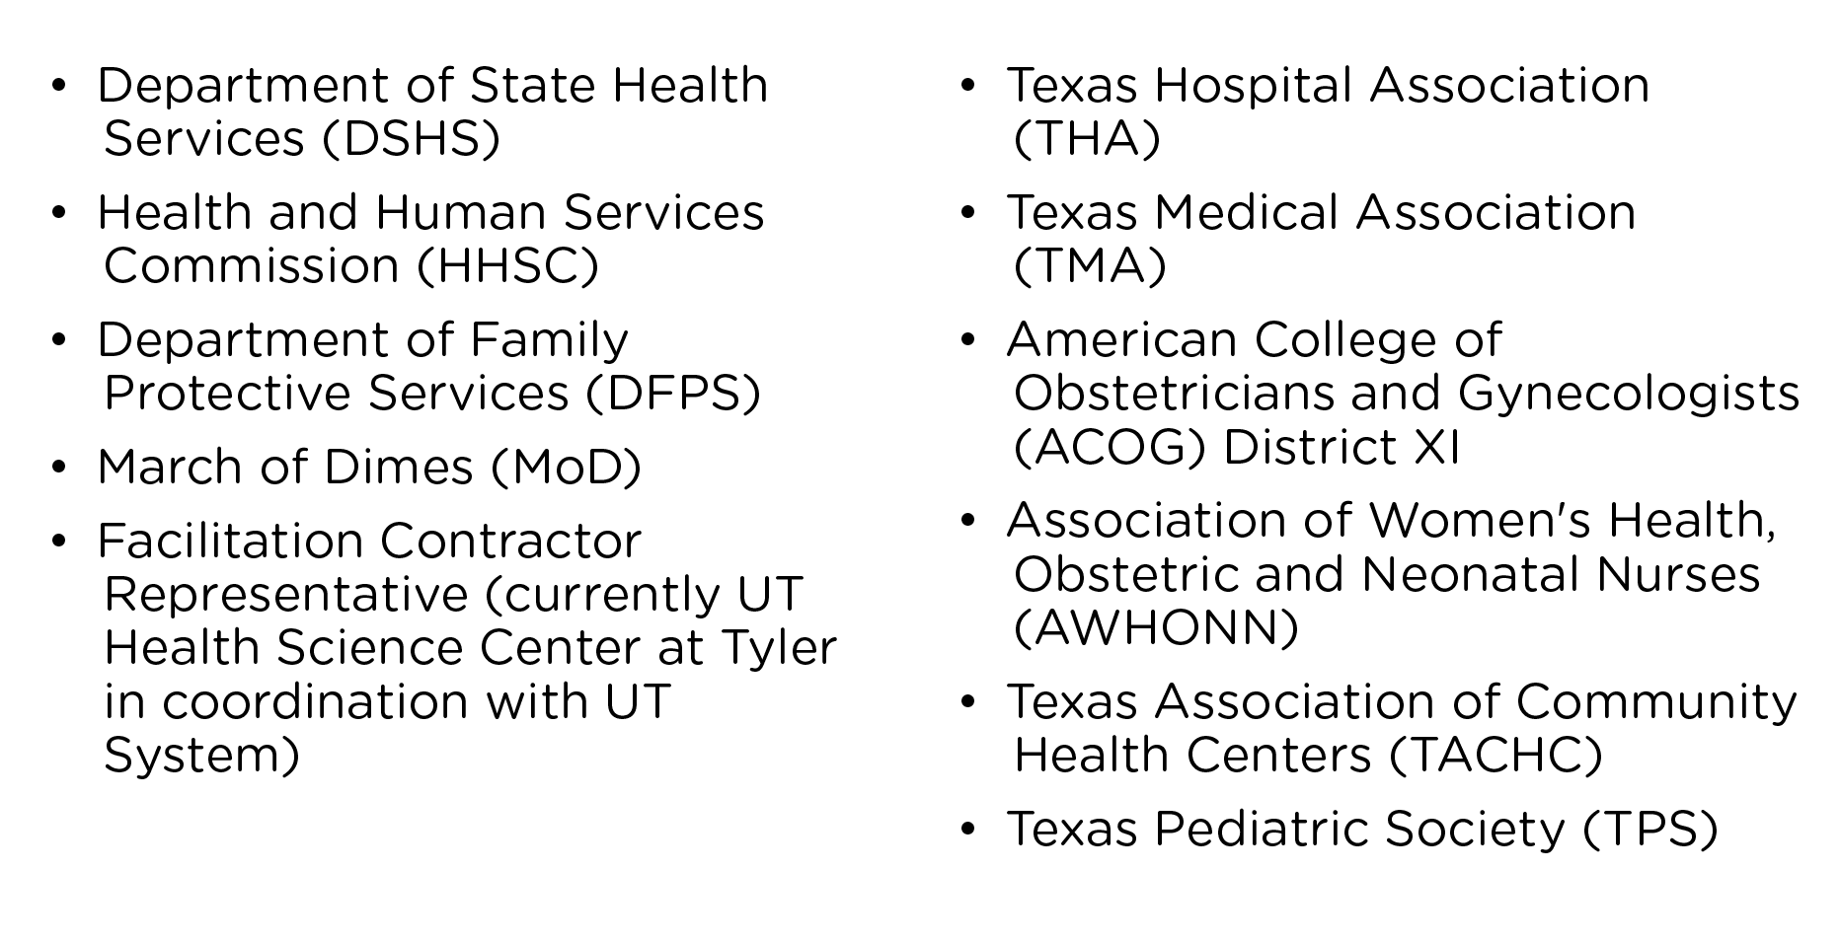
Executive committee members span a broad range of multidisciplinary health professions, including obstetrics, maternal-fetal medicine, pediatrics, neonatology, nursing, and community health, and include members of the following organizations:
Notes:
The vision of TCHMB is that:

Slide 6
Notes:
The vision of TCHMB is that:

Slide 7
TCHMB Executive Committee
Chair: Michael Speer, MD
Vice Chair/Chair-Elect: Patrick Ramsey, MD
Past Chair: George Saade, MD
Obstetrics Subcommittee Co-Chairs: Christina Davidson, MD Catherine Eppes, MD
Neonatal Subcommittee Co-Chairs: Charleta Guillory, MD Nancy Hurst, PhD
Community Health Subcommittee Co-Chairs: June Hanke, RN, MSN, MPH Janet Jones, MPH
Data Co-Chairs: Vacant
DSHS: Manda Hall, MD
HHSC: Stephanie Stephens
DFPS: Sasha Rasco, MPAff
March of Dimes: Heather Butscher, LMSW
TMA Emily Briggs, MD, MPH
THA Carrie Kroll
TACHC Jose Camacho, JD
AWHONN Shellie Nelson, MS, RN
ACOG C. Tony Dunn, MD, FACOG
TPS: Ben Raimer, MD
Notes:
Currently, the TCHMB Executive Committee consists of 11 members with at least six vacancies. The call for applications for these vacancies is open through Friday, January 20.

Slide 8
TCHMB Staff
UTHSC Tyler & UT System
David Lakey
Nagla Elerian
Dorothy Mandell
Lark Needham
Daniel Oppenheimer
Divya Patel
Jon Gibson
Em Karimifar
Meliha Salahuddin
Amanda Wagner
DSHS
Manda Hall
Jeremy Triplett
Megan Coulter
Molly Lindner
Julie Stagg
Ashley Steenberger
Allison Waage
Chris Webb
Audrey Young
Notes:
There are two teams working to support TCHMB at DSHS and UT, and they are listed here. DSHS and UT teams meet monthly as a group to plan TCHMB activities.

Slide 9
Notes:
This slide shows the goals of the collaborative. TCHMB focuses on both maternal and neonatal health outcomes. It aims to reduce negative health outcomes and increase positive health outcomes.

Slide 10
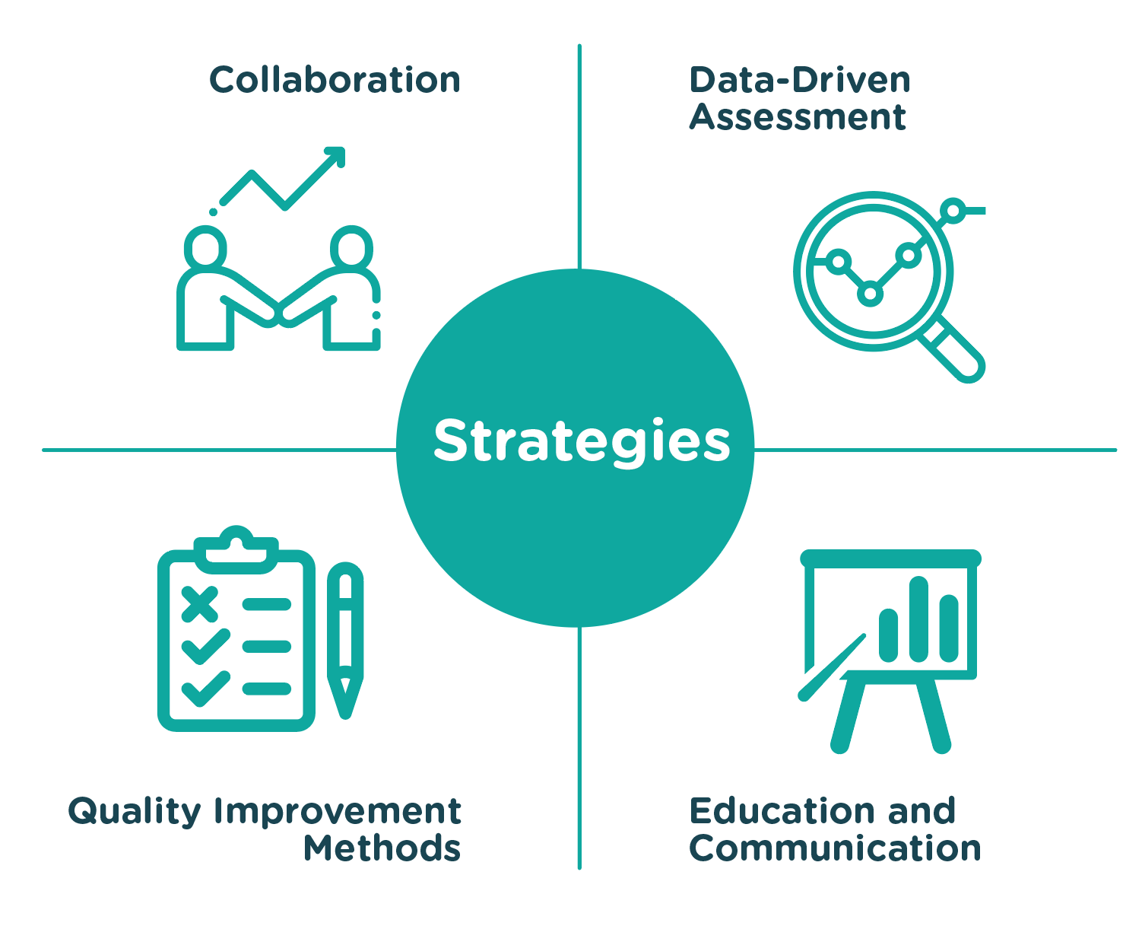
Notes:
This slide shows the goals of the collaborative. TCHMB focuses on both maternal and neonatal health outcomes. It aims to reduce negative health outcomes and increase positive health outcomes.

Slide 12
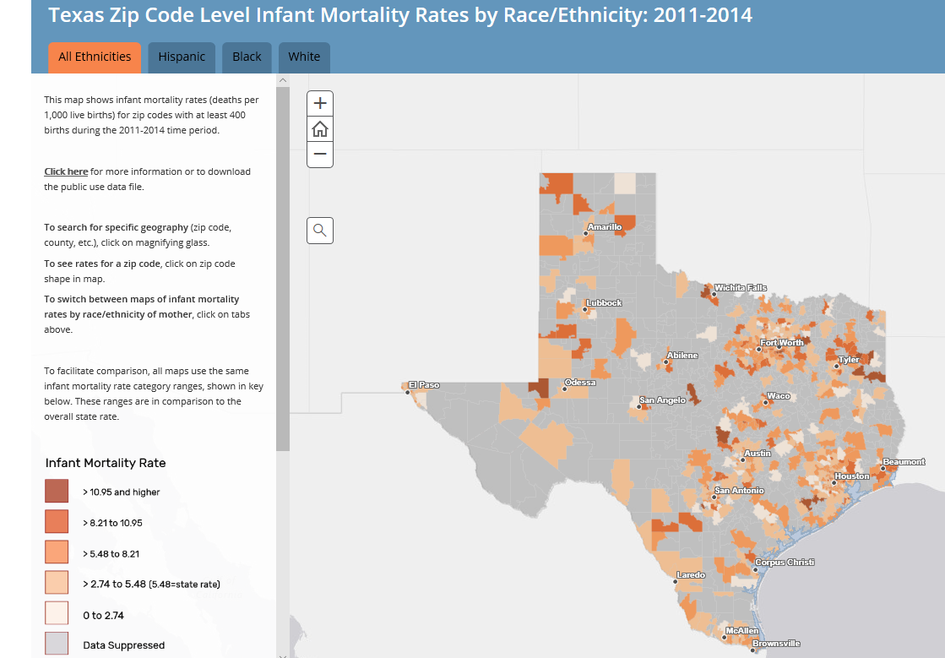
Additional Projects
Postpartum Access to Healthcare (PATH) PROJECT, Funded by St. David’s Foundation
Long Acting Reversible Contraception Strategic Plan Recommendations to the Legislature per direction of Rider 105, SB 1, 85th Legislative Session
Several Peer Reviewed Publication
Small area mapping projects
Infant Mortality in Communities Across Texas
Maternal Health Risk Factors in Communities Across Texas
Severe Maternal Morbidity in Communities Across Texas

Slide 13
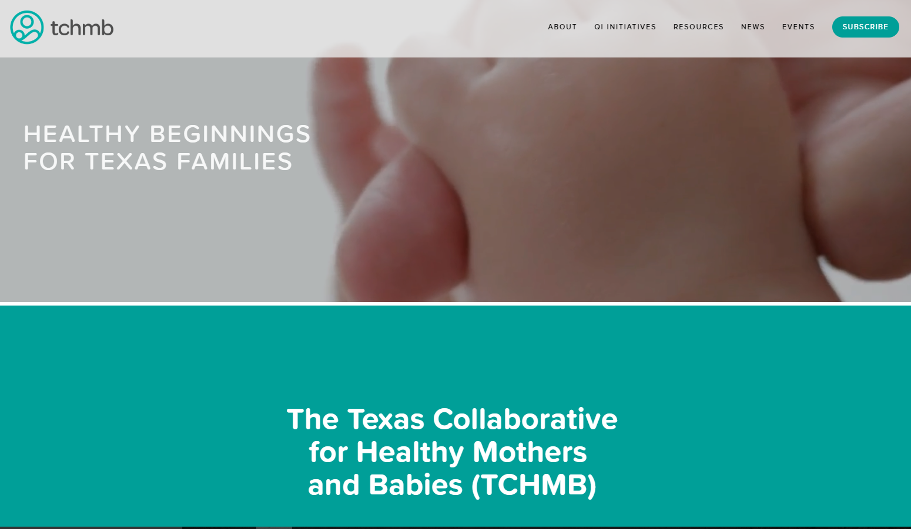
TCHMB.org
6,422 unique visitors in 2018

Slide 14
TCHMB News
Quarterly
2,044 Subscribers

Slide 15
Goals for 2019
Refine criteria for selecting projects to emphasize racial equity and health disparities
Increase recruitment of health professionals, patient and family members
Increase membership and stakeholder engagement
Utilize data, outcomes and evidence-informed and evidence-based practices to inform policy.
Focus on reducing health disparities
Align with shared goals of partner organizations

Slide 16
Thank You!
For more information on TCHMB, visit www.tchmb.org
or email us: tchmb@utsystem.edu
Notes:
and thank all of you for your attention. I’m happy to take questions now.

