Slide 1
Care Coordination and Zika Care Connect
Carey Eppes
Sharyn Malatok

Slide 2
Agenda
Introduction to Zika Care Connect
Identify gaps in the current system
Discuss potential interventions, systems to address these gaps

Slide 3
OB/GYN
Pediatrics
Public Health
Infectious Disease
Pathology/ laboratory
Hospital Administration
Policy/ethics
Notes:
Hospital/clinic administration
Pathology/lab medicine
Infectious Disease
Policy/ethics
IT/electronic health records

Slide 4
Care Coordination
Pregnancy Related Care
OB or MFM
Hospital Based Neonatal Care
Hospital evaluation and testing (Pedi or Neo)
Ophthalmology
Pediatric Care Outpatient
Infectious Disease
Genetics
Infectious Disease
Pathology/Lab
Other consultants
Ophtho
Ortho
Endocrinology

Slide 5
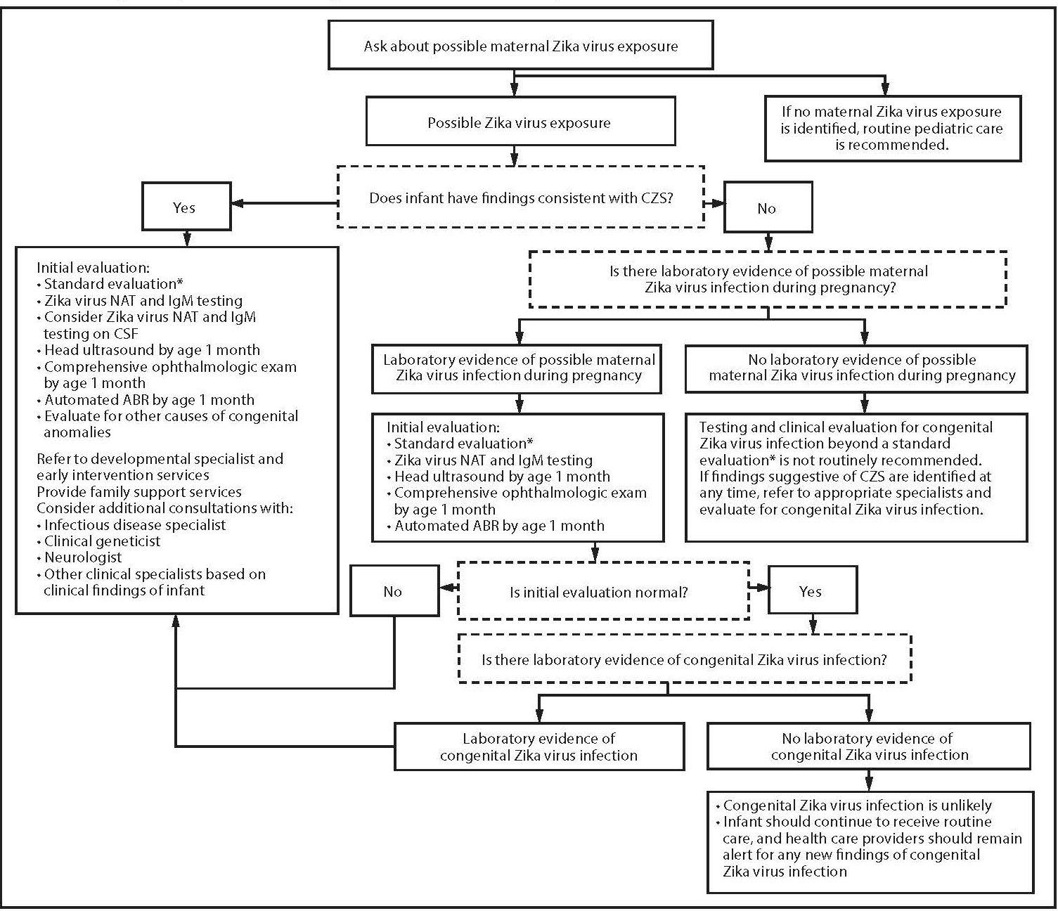

Slide 6
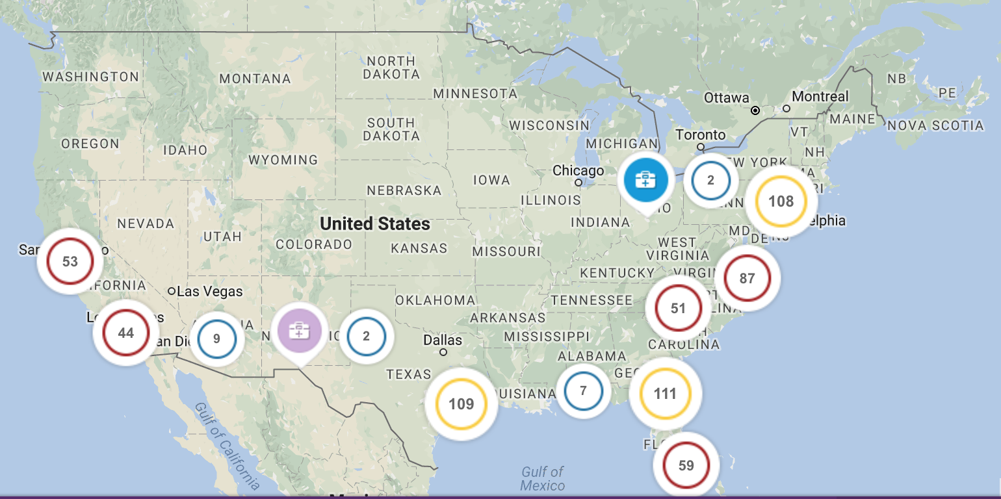
Zika Care Connect
https://www.zikacareconnect.org/find-a-doctor/

Slide 7
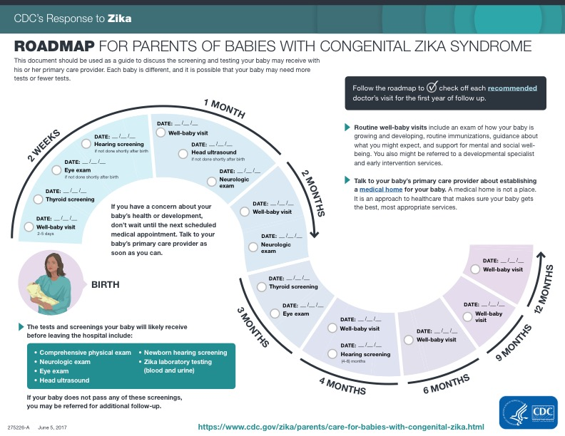
https://www.cdc.gov/zika/pdfs/roadmap-for-parents.pdf

Slide 8
Obstetrics and Pediatrics Communication
Notes:
Potential issues:
Prenatal Care or Testing in system other than Hospital of delivery
OB to Pediatrics communication (maternal testing, fetal ultrasound results)
Hospital Pediatrics to outpatient pediatrics
Patients perception of risk
Test results that return after delivery

