Slide 1




Texas Collaborative for Healthy Mothers and Babies
The Perinatal Quality Collaborative for Texas
Getting Real with REal Data:
Collecting, Stratifying and Understanding
Race, Ethnicity and Language (REaL)
Data in Health Care
October 22, 2021

Slide 2
Thank you for joining us for our webinar
“Getting Real with REaL Data”
Today’s webinar is being recorded. All documents, slides and recordings will be made available to you after the webinar concludes. If you need assistance with the webinar materials, please contact Sarah Presti at spresti@utsystem.edu.
At the end of the webinar, please complete an evaluation survey. There is a button located at the bottom of your screen “complete post-survey here”

Slide 3
Welcome and Orientation to the Platform
Notes:
We have a fast-paced agenda for you today. In the next hour, we will hear from our 3 speakers. The goal of this event is to enable the learner to:
Better understand the “life cycle” of REaL data in Texas hospitals working in the area of maternal and infant health, including the collection of accurate REaL data at intake, integration of REaL into EMRs/EHRs, and use in reporting and visualizing maternal and infant health outcomes by race, ethnicity, and language; describe the processes needed to collect and use REaL data; and identify roles/individuals in their organization who need to be engaged in order to improve the maternal and infant health data collection and use of REaL data.
Crowdcast is supported on the latest browsers including Chrome (preferred), Firefox, Microsoft Edge, and Android. We don't recommend Safari, and you won't be able to use Internet Explorer.
If you're experiencing sluggish performance, start by refreshing the window. If problems persist, restart your web browser and navigate back to the event.

Slide 4

We want to hear from you!
Your feedback is very important, and speakers want to hear from you!
If you have questions for the panelist, please click on “Ask a Question” at the bottom of your screen
Notes:
Please chime in with any questions you have throughout the webinar. All participants have been muted however you can submit text messages a couple of different ways. We have times after the presentations for you to ask questions of the speakers. Please submit your questions in the “ask the question” box located at the bottom of the screen. These will be shared directly with our staff and the panel moderator.

Slide 5
Interacting with Attendees
Please use the chat box to engage with the other attendees and panelists.
Notes:
Our hope is that the webinar is interactive and meaningful for all participants. We encourage you to connect with the other attendees on today’s webinar. To engage with the other attendees please use the Chat box.

Slide 6
Disclosure to Learners

Slide 7
Successful Completion
Successful completion of this continuing education event requires that you:
Complete registration and sign in
Attend the entire event
Participate in education activities
Complete the participant evaluation by 11:59 pm on Tuesday, October 26.

Slide 8
Disclosure to the Learner
Commercial Support
This educational activity received no commercial support.
Disclosure of Financial Conflict of Interest
The speakers and planning committee have disclosed no financial interests.
Non-Endorsement Statement
Accredited status does not imply endorsement of any commercial products or services by the Texas Department of State Health Services, CE Service; Texas Medical Association; or American Nurse Credentialing Center.
Off Label Use
The speakers did not disclose the use of products for a purpose other than what it had been approved for by the Food and Drug Administration.
Expiration for awarding contact hours/credits
Complete and submit the evaluation by 11:59 pm on Tuesday, October 26.
Notes:
Note to moderator: read the complete slide.

Slide 9
Continuing Education
Continuing Medical Education
This activity has been planned and implemented in accordance with the accreditation requirements and policies of the Texas Medical Association (TMA) through the joint providership of The Texas Department of State Health Services, Continuing Education Service and The University of Texas Health Science Center at Tyler. The Texas Department of State Health Services, Continuing Education Service is accredited by TMA to provide continuing medical education for physicians.
The Texas Department of State Health Services, Continuing Education Service designates this live activity for a maximum of 1.00 AMA PRA Category 1 CreditsTM. Physicians should claim only the credit commensurate with the extent of their participation in the activity.
Continuing Nursing Education
The Texas Department of State Health Services, Continuing Education Service is accredited as a provider of continuing nursing education by the American Nurses Credentialing Center’s Commission on Accreditation.
The Texas Department of State Health Services, Continuing Education Service has awarded 1.00 contact hours of Continuing Nursing Education.
Notes:
Continuing Education for multiple disciplines is being offered for this event. The Texas Department of State Health Services, Continuing Education Service has awarded 1 professional development hours after successful completion of this webinar.

Slide 10
Continuing Education
Certified in Public Health
Up to 1.00 CPH Recertification Credits may be earned at this event.
Licensed Professional Counselors
Up to 1.00 LPC hours may be earned at this event.
Licensed Psychologists
The Texas Department of State Health Services, Continuing Education Service is approved as a provider of professional development hours for licensed psychologists, per the Texas Administrative Code Rule §463.35 (f)(1). The Texas Department of State Health Services, Continuing Education Service has awarded 1.00 professional development hours.
Social Workers
The Texas Department of State Health Services, Continuing Education Service, the continuing education provider, ensures that the education provided is directly related to the practice of social work; and that the individuals presenting the information have the necessary experience and knowledge in the topics presented. The Texas Department of State Health Services, Continuing Education Service has awarded 1.00 hours of credit.
Certificate of Attendance
The Texas Department of State Health Services, Continuing Education Service has designated 1.00 hours for attendance.

Slide 11
Presenting today:
Christina Davidson, MD
Luke Horton
Sean McGowen
Notes:
Dr. Christina Davidson is a board-certified Maternal Fetal Medicine specialist and the Vice Chair of Quality, Patient Safety & Equity for the Department of Obstetrics & Gynecology at Baylor College of Medicine. She is also the Chief Quality Officer for Obstetrics & Gynecology at Texas Children’s Hospital, a co-chair of the Obstetrics subcommittee of the Texas Collaborative for Healthy Mothers and Babies, and the Vice Chair of the Society for Maternal-Fetal Medicine Patient Safety and Quality Committee.
Luke is the Manager of Revenue Cycle Education and Training at Texas Children's Hospital. Luke's team is responsible for training all Revenue and Access job roles across the organization. He has been an Epic trainer for 14 years and specializes in Epic software training and eLearning development
Sean is the Ambulatory Business Manager for The Texas Children’s Maternal Fetal Center. He is a native Houstonian who returned to Houston after his military service in the United States Navy. Sean has over 20 years of management and customer service experience. He begin his 11 year tenure with Texas Children’s at West Campus in Cardiology, Pulmonary and Orthopedics as an Ambulatory Services Representative.

Slide 12
Webinar Objectives
Describe the use of REaL (Race, Ethnicity, and Language) data in quality improvement to support achievement of equitable health care
Describe recommended processes/steps for collection of accurate and complete REaL data

Slide 13
Webinar Outline
Rationale for the collection and use of REaL data
Case study: AIM bundle implementation in Texas Children’s Hospital Pavilion for Women
“Life cycle” of REaL data collection and use, and uniform framework for collection of accurate and complete REaL data
Minimum standards for data collection required in Texas
Who in the organization needs to be engaged in order to improve the collection and use REaL data

Slide 14
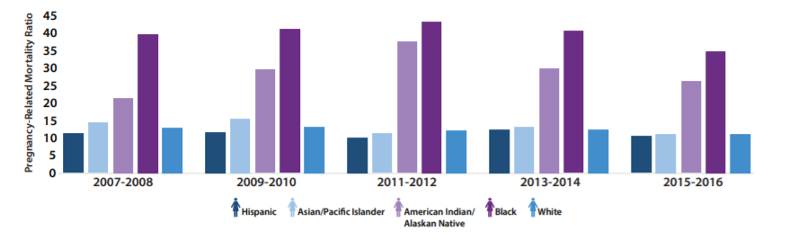
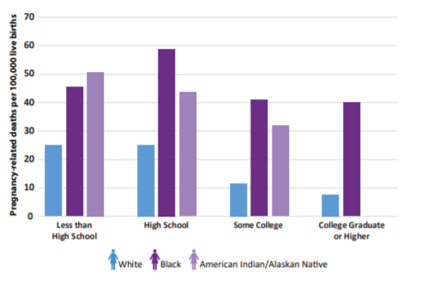
Racial/Ethnic Disparities in Pregnancy-Related Deaths:
United States, 2007–2016
https://www.cdc.gov/reproductivehealth/maternal-mortality/disparities-pregnancy-related-deaths/infographic.html
Notes:
https://www.cdc.gov/reproductivehealth/maternal-mortality/disparities-pregnancy-related-deaths/infographic.html
About 700 women die each year in the U.S. as a result of pregnancy or its complications.
American Indian/Alaska Native and Black women are 2 to 3 times as likely to die from a pregnancy-related cause than white women. Black women are 3–4 times more likely to die a pregnancy-related death as compared with white women, and this is independent of education, income, and comorbidities.
The PRMR (which is an estimate of the number of pregnancy-related deaths for every 100,000 live births) for black women with at least a college degree was 5 times as high as white women with a similar education. Non-Hispanic Black women with graduate degrees have higher rates of severe maternal morbidity than non-Hispanic White women who never graduated from high school.
Inequities increase by age, with the disparity for black and AI/AN women older than 30 years four to five times that of their white counterparts. For example, the disparity ratio for black women compared to white women ranged from 1.5 among the <20 years age group to 4.3 for the 30–34 years age group.
State Pregnancy-Related Mortality Ratios (PRMR) were placed equally into three groups (high, medium, low) and the PRMR was further calculated by race/ethnicity for each group. Even in states with the lowest PRMR, the PRMR for black women was about 3 times as high as the PRMR for white women.
CDC: Pregnancy-related death is defined as “the death of a woman while pregnant or within 1 year of pregnancy termination—regardless of the duration or site of the pregnancy—from any cause related to or aggravated by the pregnancy or its management, but not from accidental or incidental causes.” This definition relies on the connected causality of the WHO definition, but extends the time frame to one year, with a subclassification of late pregnancy related death for those beyond 42 days. Pregnancy-associated death is defined as “all deaths during pregnancy or within 1 year of pregnancy regardless of cause,” which forms a collection of cases from which to find pregnancy-related death.
The WHO uses the term “maternal death” to identify maternal mortality defined as “the death of a woman while pregnant or within 42 days of termination of pregnancy, irrespective of the duration and site of the pregnancy, from any cause related to or aggravated by the pregnancy or its management but not from accidental or incidental causes.”

Slide 15
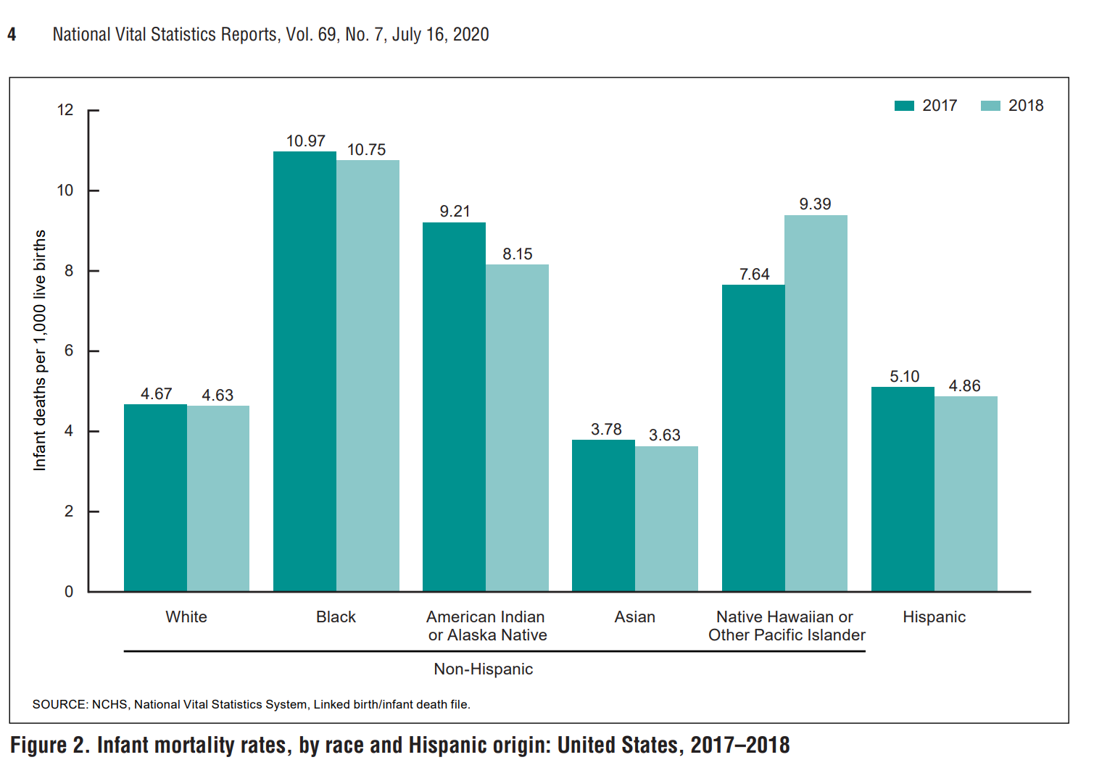
Notes:
Infant mortality also varies by race. In the United States, Black newborns die at 2-3X the rate of White newborns. When looking at infant mortality rates by race and ethnicity in the Unites States in 2017-2018, infants of non-Hispanic black women had the highest mortality rate (10.75), followed by infants of non-Hispanic Native Hawaiian or Other Pacific Islander (9.39), non-Hispanic American Indian or Alaska Native (8.15), Hispanic (4.86), non-Hispanic white (4.63), and non-Hispanic Asian (3.63) women.
Additionally, a recent publication examining 1.8 million hospital births in the state of Florida between 1992 and 2015 suggest that newborn– physician racial concordance is associated with a significant improvement in mortality for Black infants. Under the care of White physicians, Black newborns experience triple the in-hospital mortality rate of White infants. Results further suggest that these benefits manifest during more challenging births and in hospitals that deliver more Black babies. We find no significant improvement in maternal mortality when birthing mothers share race with their physician.

Slide 16
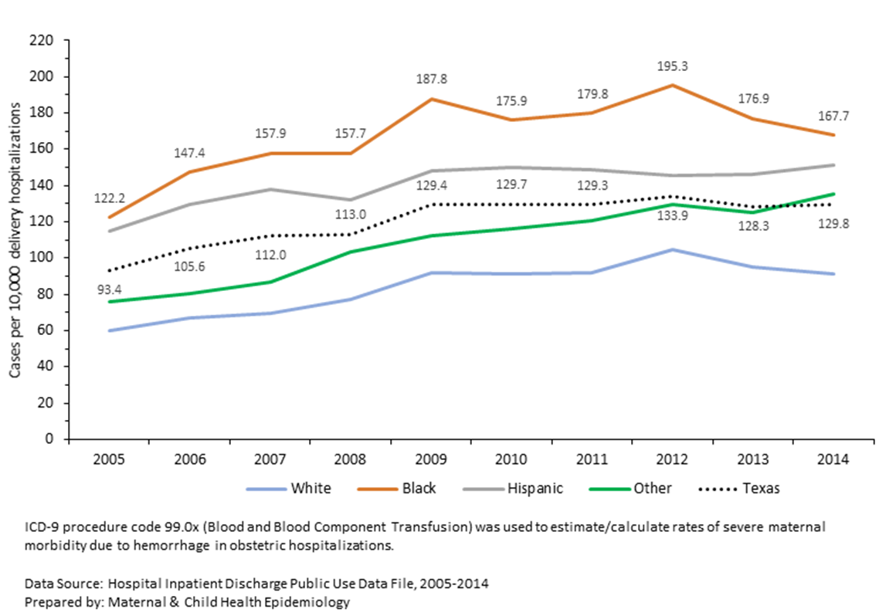
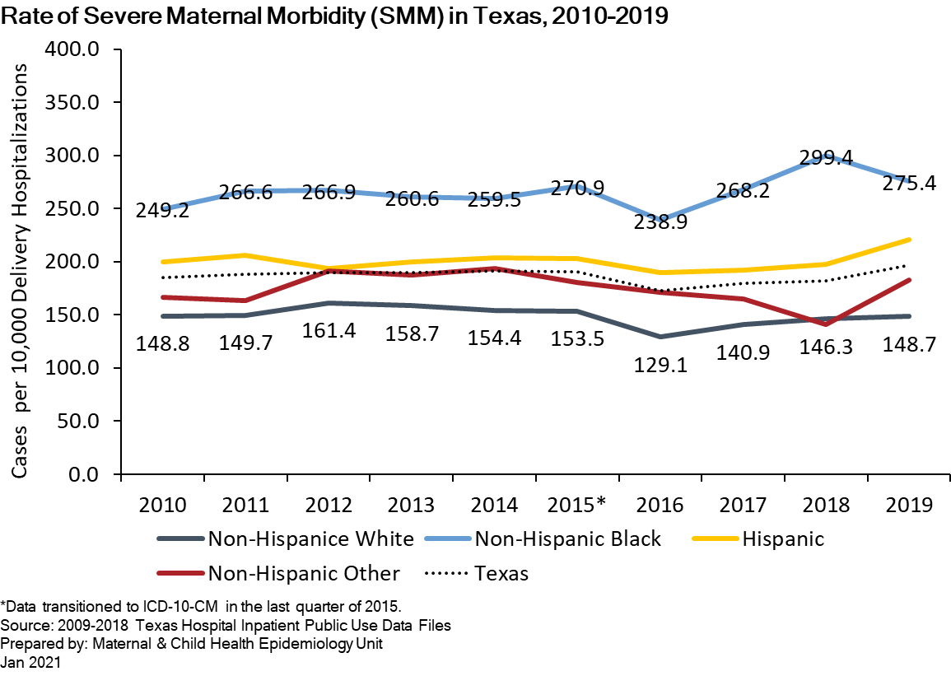
Severe Maternal Morbidity in Texas by Race and Ethnicity
Obstetric Hemorrhage Rates in Texas (estimated by blood transfusion procedures), 2005-2014
Texas Department of State Health Services. Maternal Mortality and Morbidity Task Force and Department of State Health Services Joint Biennial Report, September 2018
Texas Department of State Health Services Maternal and Child Health Epidemiology. 2020 Healthy Texas Mothers and Babies Data Book. March 2021.
Notes:
The United States has the highest maternal mortality rate of any high resource country—and it is the only country outside of Afghanistan and Sudan where the rate is rising.
Whereas every other developed country seems to be decreasing its MM rate, the US rate is increasing.
Black women are 3–4 times more likely to die a pregnancy-related death as compared with white women, and this is independent of education, income, and comorbidities.
Most maternal deaths occur more than 42 days after delivery

Slide 17
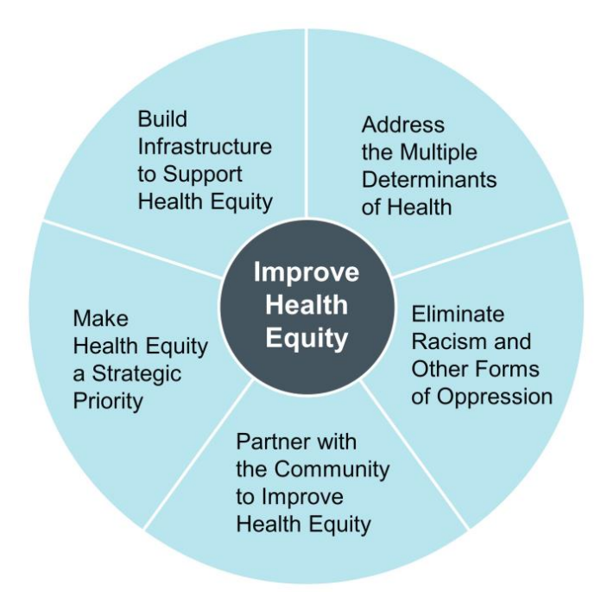
IHI’s Health Equity Framework
Strategy 1: Create the Data Infrastructure to Improve Health Equity
Strategy 2: Display and Use Stratified Data
Improving Health Equity: Build Infrastructure to Support Health Equity. Guidance for Health Care
Organizations. Boston, Massachusetts: Institute for Healthcare Improvement; 2019. (Available at www.ihi.org)
Notes:
There are 5 core elements to the IHI’s Health Equity Framework – I’m going to go over 4 of them briefly. The 5th is related to partnering with the community and outside the scope of this workshop. However, there are detailed guides for all 5 elements on the IHI’s website.
The IHI also has the Improving Health Equity Assessment tool available on their website; that tool helps hospitals evaluate their current health equity efforts to identify areas for improvement. It is to be completed by senior leadership responsible for health equity within the organization. They each complete it individually and then meet to compare and discuss. The leadership can then identify goals and incorporate them into the strategic plan for the organization. Each department then aligns their goals with the organization’s strategic plan.
Make Health Equity a Strategic Priority
Organizational leaders commit to improving health equity by including equity in the organization’s strategy and goals. Equity is viewed as mission critical — that is, the mission, vision, and business cannot thrive without a focus on equity.
• Build Infrastructure to Support Health Equity
Operationalizing a health equity strategy requires dedicated resources, including human resources and data resources, as well as an organizational infrastructure.
• Address the Multiple Determinants of Health
Health care organizations must develop strategies to address the multiple determinants of health, including health care services, organizational policies, the organization’s physical environment, the community’s socioeconomic status, and encouraging healthy behaviors.
• Eliminate Racism and Other Forms of Oppression
Health care organizations must look at their systems, practices, and policies to assess where inequities are produced and where equity can be proactively created.
• Partner with the Community to Improve Health Equity
To support communities to reach their full health potential, health care organizations must work in partnership with community members and community-based organizations that are highly engaged with community members

Slide 18


Race, Ethnicity & Language
REaL Data

Slide 19
The “Life Cycle” of REaL Data
Process 1:
Uniform Data Collection and Validation
Process 2:
Use in Improvement Projects
REaL data collection
Data validation & QI
(Repeat validation process and training/QI as needed)
Identifying quality improvement metrics for stratification
Linking data (if needed; e.g., registration data and medical records)
Extracting and stratifying metrics
Visualization for use in improvement processes
(Repeat steps 2-4 at regular intervals throughout project)
Source: Based on AHA (2021) Data-Driven Care Delivery: Data Collection, Stratification and Use. Available from: https://ifdhe.aha.org/system/files/media/file/2021/04/ifdhe_real_data_toolkit_1.pdf

Slide 20
REaL Data: OMB Standard Categories
Ethnicity | Race | Combined Race/Ethnicity
Hispanic or Latino | American Indian or Alaska Native | American Indian or Alaska Native
Not Hispanic or Latino | Asian | Asian
 | Black or African American | Black, not of Hispanic origin
 | Native Hawaiian or Other Pacific Islander | Native Hawaiian or Other Pacific Islander
 | White | White, not of Hispanic origin
Office of Management & Budget (OMB) DIRECTIVE 15: RACE AND ETHNIC STANDARDS FOR FEDERAL STATISTICS AND ADMINISTRATIVE REPORTING (cdc.gov)
Notes:
The OMB developed standardized categories for race and ethnicity and as a result many health care organizations adopted the OMB categories. Additionally, the OMB categories for race and ethnicity are included in all electronic health records. OMB standards also enable individuals to select multiple racial categories. (ref = IHI)
Office of Management and Budget (OMB)
Office of Management and Budget (OMB) Standards | Office of Research on Women's Health (nih.gov)
OMB DIRECTIVE 15: RACE AND ETHNIC STANDARDS FOR FEDERAL STATISTICS AND ADMINISTRATIVE REPORTING (cdc.gov)

Slide 21
Reasons for Stratifying REaL Data
Identify
Identify where inequities exist in order to target quality improvement initiatives to reduce gaps between groups
Understand
Understand the demographics of the community served by the organization
Satisfy
Satisfy requirements in grant applications and for potential funders
Align
Better align the health care workforce composition with the community served
Meet
Meet contractual compliance obligations
Provide & manage
Provide and manage interpreter services
Improving Health Equity: Build Infrastructure to Support Health Equity. Guidance for Health Care
Organizations. Boston, Massachusetts: Institute for Healthcare Improvement; 2019. (Available at www.ihi.org)

Slide 22
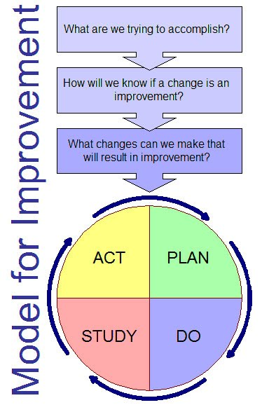
Using Data Stratification to Improve Health Equity
What are we trying to accomplish?
  Provide organizational leaders with strategic measures stratified by race, ethnicity, language to reveal disparities that can be reduced/eliminated to improve care
How will we know that a change is an improvement?
  Stratified data helps organizations identify inequities, inform action, improve overall performance
What change can we make that will result in improvement?
  Identify one strategic measure the organization wants to improve and provide stratified data for that measure to identify opportunities for improvement
IHI Improving Health Equity: Build Infrastructure to Support Health Equity
Notes:
An approach proposed by the IHI is to use REaL data to stratify one strategic measure to build will and interest among leaders and clinicians. Fast deployment of stratified data for one strategic measure versus waiting for development of an entire dashboard allows the organization to learn and understand aspects of equity in practice. This approach supports IHI’s current recommendation that organizations should gain experience in improving equity by first applying an “equity lens” to existing improvement projects aligned with strategic priorities rather than chartering new projects with the specific focus to improve equity.
There are two distinct approaches in using QI to address disparities, both of which emphasize the tailoring of interventions to meet the cultural and linguistic needs of the populations of focus. The difference lies in the use of data in the identification of disparities and monitoring of improvement. One approach, commonly used in research and practice, is to focus on improving care for a population that has historically experienced disparities in care or is an underserved population. With this approach, the use of REAL data to monitor differences among and between groups is not emphasized. Improved equity is determined by assessing if interventions lead to improvements in baseline measures. The second and ideal approach is to use REAL data to demonstrate gaps in care by comparing a quality measure among two (or more) groups. For example, colon cancer screening rates for English speaking patients are compared with screening rates for non-English speakers. Improved equity is evaluated by looking for better quality of care and a decrease in the gap between groups. This approach is impossible to do without high quality REAL data. Using this approach, QI can result in three possible effects on equity. First, it can improve care for both groups but have no effect on the gap. Or, QI can improve quality of care and reduce the gap. Lastly, improvement efforts can widen the gap by improving care for one group while worsening it for the second group. Stratifying quality measures improves accuracy and quality of data and therefore allows more efficient and cost effective use of QI resources. This approach also provides a way to demonstrate which practices result in improved equity and can be spread to other systems and settings. Quality improvement may not benefit all populations equally. Careful measurement is vital to improving equity. Focused analysis of data can help uncover disparities between and within populations. These data should be monitored as improvements © 2012 Center for the Health Professions at the University of California, San Francisco Bringing Equity into Quality Improvement: An Overview of the Field and Opportunities Ahead 13 are made to confirm that the changes resulting in the intended goal of diminishing gaps in the quality of care.(Ref=Bringing Equity into Quality Improvement: An Overview and Opportunities Ahead)
IHI Improving Health Equity: Build Infrastructure to Support Health Equity
http://www.ihi.org/Engage/Initiatives/Pursuing-Equity/Pages/default.aspx

Slide 23
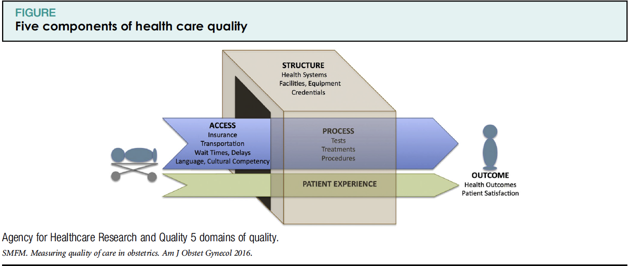
Quality Measures
Notes:
Structure measures: the organization’s infrastructure, capacity, systems, and processes
Process measures: the way services are delivered; the activities done to provide care
Outcome measures: the overall impact or results of the care provided
Balancing measures: check for unintended outcomes
Structural Measures
Structural measures give consumers a sense of a health care provider’s capacity, systems, and processes to provide high-quality care. For example:
Whether the health care organization uses electronic medical records or medication order entry systems.
The number or proportion of board-certified physicians.
The ratio of providers to patients.
Process Measures
Process measures indicate what a provider does to maintain or improve health, either for healthy people or for those diagnosed with a health care condition. These measures typically reflect generally accepted recommendations for clinical practice. For example:
The percentage of people receiving preventive services (such as mammograms or immunizations).
The percentage of people with diabetes who had their blood sugar tested and controlled.
Process measures can inform consumers about medical care they may expect to receive for a given condition or disease, and can contribute toward improving health outcomes. The majority of health care quality measures used for public reporting are process measures.
Outcome Measures
Outcome measures reflect the impact of the health care service or intervention on the health status of patients. For example:
The percentage of patients who died as a result of surgery (surgical mortality rates).
The rate of surgical complications or hospital-acquired infections.
Outcome measures may seem to represent the “gold standard” in measuring quality, but an outcome is the result of numerous factors, many beyond providers’ control
AHRQ: Types of Health Care Quality Measures | Agency for Healthcare Research and Quality (ahrq.gov)

Slide 24
Case Study
Texas Children’s Hospital Pavilion for Women

Slide 25


Texas Children’s Hospital Pavilion for Women
Level IV Maternal and Neonatal hospital located in Texas Medical Center
~6500 deliveries/year
24/7 coverage by Ob/Gyn Hospitalists, Critical Care Medicine, and BCM Residents
Patient demographics:
  38% Hispanic
  34% Non-Hispanic White
  20% Non-Hispanic Black
  8% Asian/Other
  40% Medicaid
  10% non-English preferred language

Slide 27
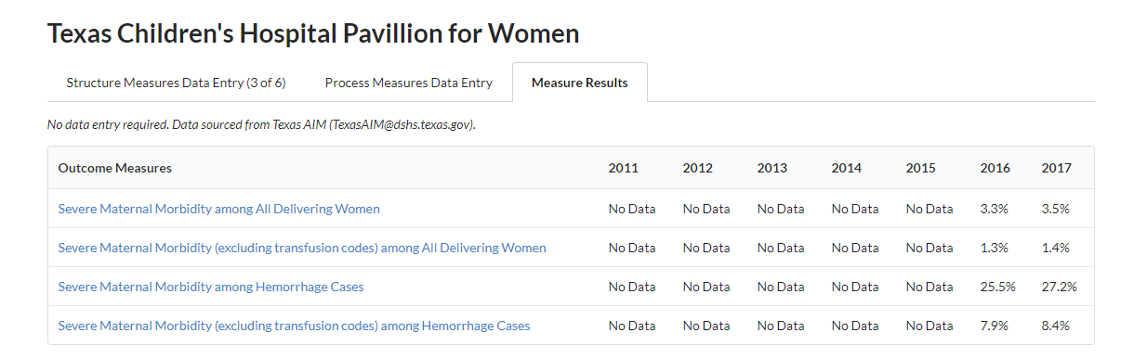
Texas baseline (2011-2015): 30.9% SMM among hemorrhages
TexasAIM Goal: reduce hemorrhage SMM by 25%

Slide 28
SMM and SMM-Hemorrhage
SMM numerator = delivery admissions with any SMM
SMM denominator = delivery admissions
SMM-hemorrhage numerator = delivery admissions with any SMM
SMM-hemorrhage denominator = delivery admissions with a hemorrhage diagnosis

Slide 29
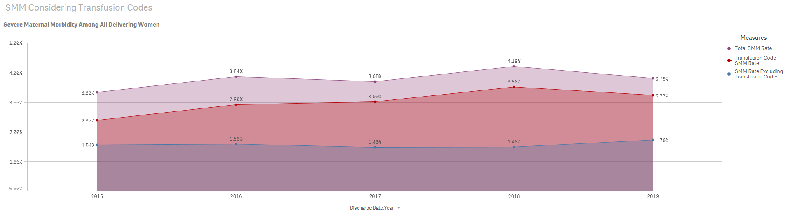
Data Presented at Texas Children’s Pavilion for Women Department Meeting: January 2019
SMM Rates October 2015 – January 2019

Slide 30
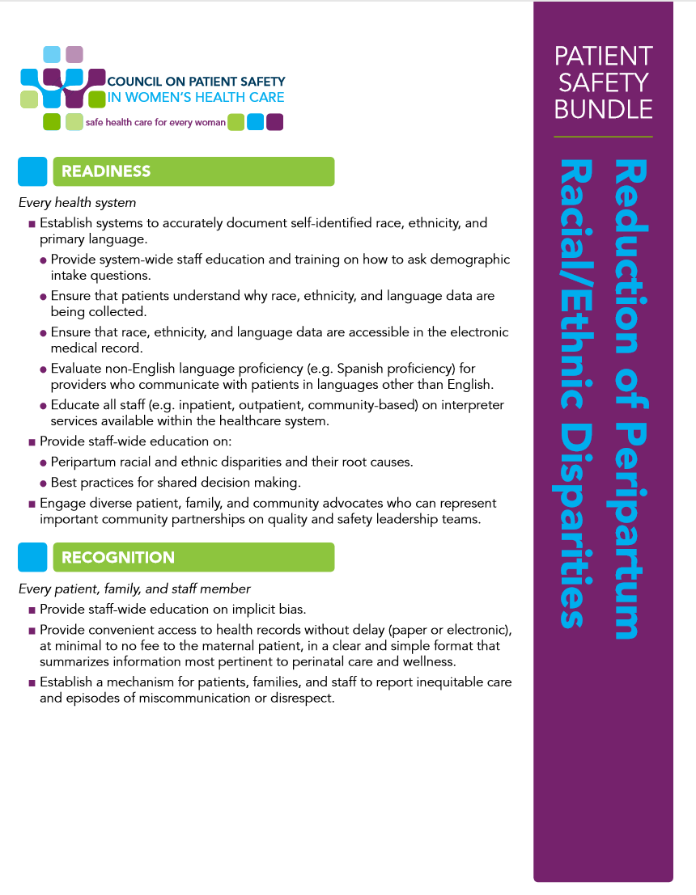
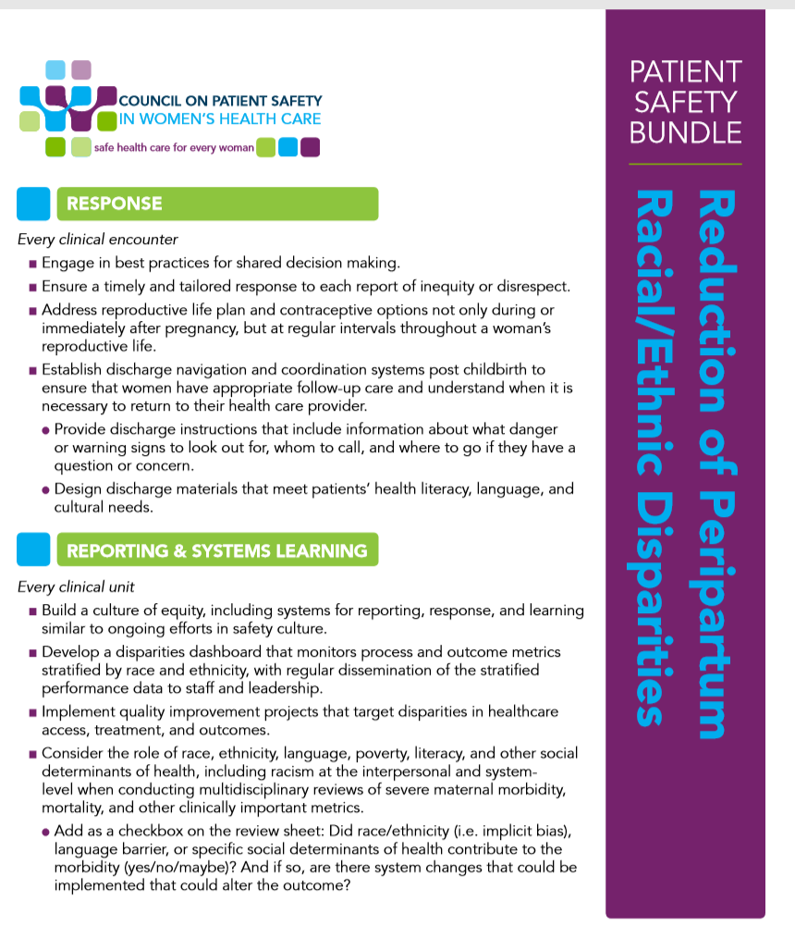

Slide 31
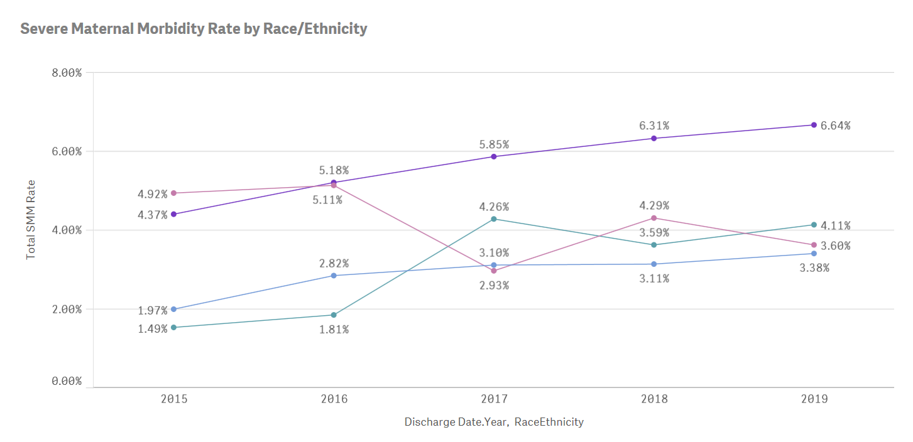
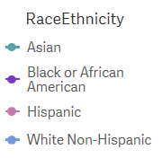
Data Presented at Texas Children’s Pavilion for Women Department Meeting: March 2019
Calendar Year View
Numerator = delivery admissions in Black women with any SMM
Denominator = delivery admissions in Black women

Slide 32
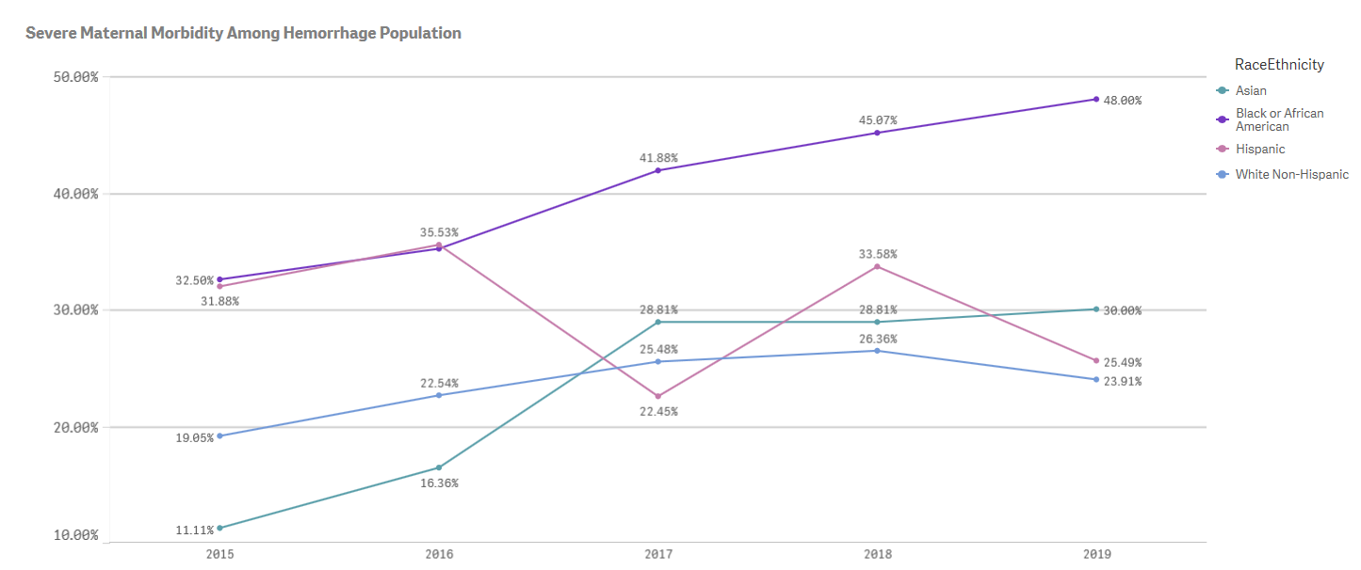
Data Presented at Texas Children’s Pavilion for Women Department Meeting: March 2019
Calendar Year View
Numerator = delivery admissions in Black women with any SMM
Denominator = delivery admissions in Black women with a hemorrhage diagnosis

Slide 33
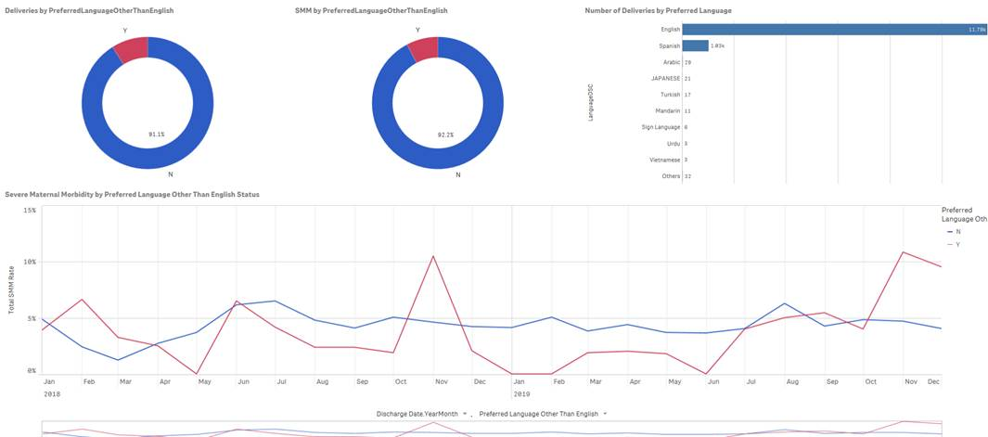
Severe Maternal Morbidity and Preferred Language

Slide 34
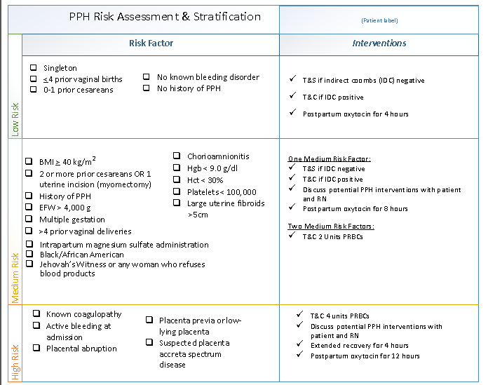
due to health disparities from unconscious bias
Notes:
Readiness – every unit
Is your team ready for an emergency?
Recognition – every patient
How does your team recognize patients at risk or experiencing deterioration?
Response – every emergency
What is your team’s response to an emergency?
Reporting – every unit
How does your team improve and learn?

Slide 35
Notes:
The rate of SMM in Black women decreased from 7.11 in the baseline group to 5.09% in the post-intervention group, and this was statistically significant (p=.038). We experienced a reduction in SMM amongst Black women immediately after presenting stratified data to the department and before completing implementation of the remaining bundle elements. However, there was evidence of special cause of variation beginning in August 2019, which correlates with the implementation of the hemorrhage risk assessment and debriefs and QBL measurement.

Slide 36
Notes:
The rate of SMM-H in Black women decreased from 45.45% to 31.58% (p=.011).

Slide 37
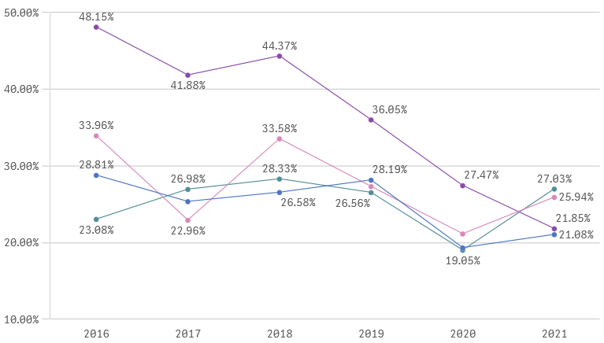
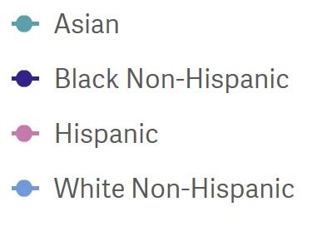
Severe Maternal Morbidity among Hemorrhage Population by Race/Ethnicity
October 2016 – June 2021

Slide 38
The “Life Cycle” of REaL Data
Process 1:
Uniform Data Collection and Validation
Process 2:
Use in Improvement Projects
REaL data collection
Data validation & QI
(Repeat validation process and training/QI as needed)
Identification of quality improvement metrics for stratification
Data linking (if needed; e.g., registration data and medical records)
Metric extraction and stratification
Visualization for use in improvement processes
(Repeat steps 2-4 at regular intervals throughout project)
Source: Based on AHA (2021) Data-Driven Care Delivery: Data Collection, Stratification and Use. Available from: https://ifdhe.aha.org/system/files/media/file/2021/04/ifdhe_real_data_toolkit_1.pdf
Notes:
Next slides will go over data collection and validation; future webinars focused on use in improvement projects

Slide 39
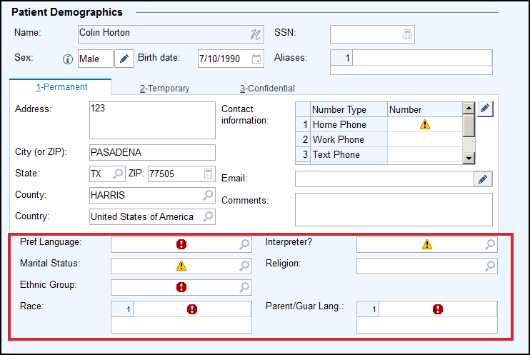
Capturing Data in Epic

Slide 40
Minimum Standards for REaL Data Collection
In 1997, the Office of Management and Budget (OMB) developed standardized questions on race and ethnicity required for reporting by federal agencies and recipients of federal funds. To ensure data quality, OMB advises collecting race and ethnicity data using two questions, with ethnicity being collected first.
First, do you consider yourself Hispanic or Latino?
Yes
No
Declined
Unknown
Which category or categories best describe your race?”
American Indian or Alaska Native
Asian
Black or African American
Native Hawaiian or Other Pacific
White
Declined
Unknown
Other Race
https://www.hcup-us.ahrq.gov/datainnovations/raceethnicitytoolkit/nm2.pdf
Notes:
The OMB developed standardized categories for race and ethnicity and as a result many health care organizations adopted the OMB categories. Additionally, the OMB categories for race and ethnicity are included in all electronic health records. OMB standards also enable individuals to select multiple racial categories.

Slide 41
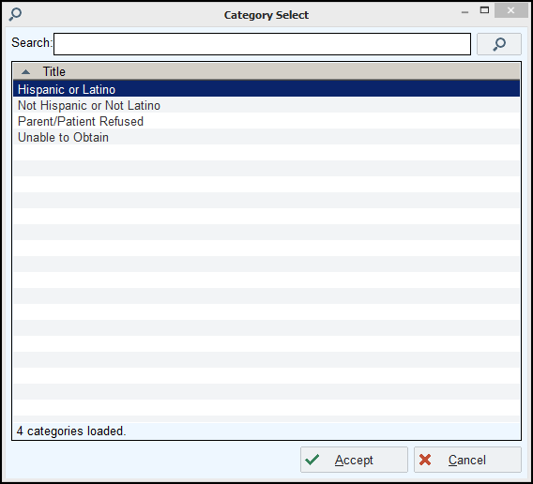
Capturing Data in Epic: Ethnic Group

Slide 42
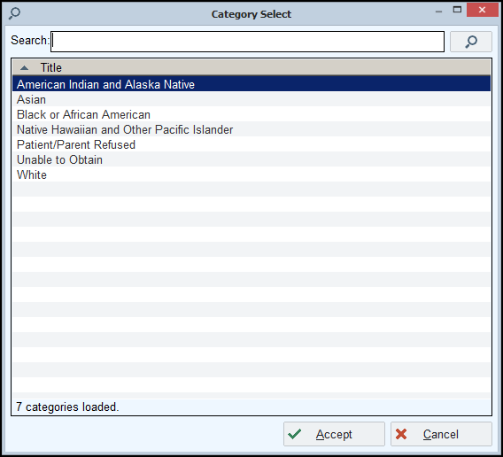
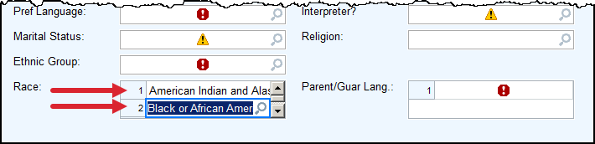
Capturing Data in Epic: Race

Slide 43
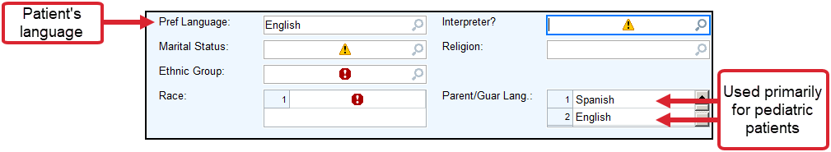
Primary Language Data Collection
In addition to race and ethnicity, the OMB data collection standards include a question for capturing English language proficiency and optional question for language spoken at home:
Data Standard for Primary Language:
How well do you speak English?
  Very well
  Well
  Not at all
  Not well
Language Spoken Standard (optional):
Do you speak a language other than English at home?
  Yes
  No
Source: U.S Department of Health And Human Services Implementation Guidance On Data Collection Standards For Race, Ethnicity, Sex, Primary Language, And Disability Status. Available at: https://aspe.hhs.gov/reports/hhs-implementation-guidance-data-collection-standards-race-ethnicity-sex-primary-language-disability

Slide 44
Texas Law
Racial and ethnic background required to be collected on healthcare facility inpatients and outpatients by Texas State law
Patient should self-report: if patient unable (e.g., comatose, severely injured, died shortly after admission) or declines, healthcare facility staff should use best judgment to identify patient’s ethnic and racial background
Source: https://dshs.texas.gov/thcic/hospitals/5010_InpatientandOutpatientAppendices.pdf
Texas State law Chapter 108, Texas Health & Safety Code and administrative rules found at Title 25 Texas Administrative Code, Chapter 421, Rule 421.9 (C) 1 and 2 or Title 25 Texas Administrative Code, Chapter 421, Rule 421.67 (C) 1 and 2.
Notes:
All hospitals must collect the data, however there are opportunities to improve data accuracy and completeness. In addition, Texas does not require the collection of primary language data.

Slide 45
Uniform Framework and Strategies for Data Collection
Rationale for providing information
Script for staff
Method for self-reporting
Standardized approach for using OMB categories for analysis and reporting
Assurances for confidentiality
Source: AHA (2021) Data-Driven Care Delivery: Data Collection, Stratification and Use. Available from: https://ifdhe.aha.org/system/files/media/file/2021/04/ifdhe_real_data_toolkit_1.pdf
Notes:
A rationale for why the patient is being asked to provide this information.
A script for staff to use each time so that they ask questions in a uniform fashion.
A method for allowing patients to self-report their information.
A standardized approach for “rolling up” granular responses to the U.S. Office of Management and Budget categories for analytical and reporting purposes.
Assurances that the data will be held confidential and that a limited number of people will have access to the data and a mechanism to ensure compliance.

Slide 46
Questions to Guide REaL Data Collection Improvements
Does our organization have a unified framework for consistently collecting data on demographics, language preference and ways information is received to improve the quality of care for all patients?
Has our organization assembled a working group to focus on REaL data and health care disparities? If so, is diversity reflected among the members of the working group? (This might include age, race/ethnicity, language, work unit, gender identity, etc.)
What steps has our organization taken to standardize the data collection process?
Do we offer information for patients regarding why and for what purpose REaL data will be used and collected?
What protocols do we have in place for addressing concerns from patients who inquire about the collection of their demographic data?
Source: AHA (2021) Data-Driven Care Delivery: Data Collection, Stratification and Use. Available from: https://ifdhe.aha.org/system/files/media/file/2021/04/ifdhe_real_data_toolkit_1.pdf

Slide 47
Organization Engagement
Key areas to be represented in improving the collection and use of REaL data:
Diversity and inclusion Quality and safety Information and technology Data analytics | Language services Admitting and registration Compliance Community outreach
Source: Health Research & Educational Trust. (2014). A framework for stratifying race, ethnicity and language data. Available from: www.hpoe.org
Notes:
A first step in improving the collection and use of REaL data in quality improvement is to assemble a workgroup that includes leaders from hospital departments that collect REAL data, produce analytics, perform quality improvement and are engaged in community outreach efforts. Involving staff from departments related to diversity, data, analytics, patient safety, information technology, quality/ performance improvement, patient experience, corporate auditing and finance in discussions will create a more comprehensive plan.

Slide 48
Training Resources
Referenced in this presentation:
Data-Driven Care Delivery: Data Collection, Stratification and Use. American Hospital Association; 2021. https://ifdhe.aha.org/system/files/media/file/2021/04/ifdhe_real_data_toolkit_1.pdf
A framework for stratifying race, ethnicity and language data. Health Research & Educational Trust; 2014. www.hpoe.org
Implementation Guidance On Data Collection Standards For Race, Ethnicity, Sex, Primary Language, And Disability Status. U.S Department of Health And Human Services; 2011. https://aspe.hhs.gov/reports/hhs-implementation-guidance-data-collection-standards-race-ethnicity-sex-primary-language-disability
Improving Health Equity: Build Infrastructure to Support Health Equity. Guidance for Health Care Organizations. Boston, Massachusetts: Institute for Healthcare Improvement; 2019. http://www.ihi.org/resources/Pages/Publications/Improving-Health-Equity-Guidance-for-Health-Care-Organizations.aspx
Additional resources:
Collecting Patient Data: Improving Health Equity In Your Practice
American Medical Association
This online module discusses the importance of collecting patient race and ethnicity data, explains the minimum standards for collecting these data, and elucidates how race and ethnicity data can be used to improve quality outcomes. Participants will learn about establishing standards for race and ethnicity data collection in their practice and how to train staff to collect these data. https://edhub.ama-assn.org/interactive/17579528
HRET Disparities Toolkit: A Toolkit for Collecting Race, Ethnicity, and Primary Language Information from Patients
Health Research and Educational Trust
This toolkit provides guidance for health care organizations on how to collect REaL data from patients. It contains federal guidelines and recommendations for collecting data; modules and scripts for frontline staff; evaluative tools; and guidance on how to use REaL data for quality-improvement initiatives. Health care organizations and providers can use this toolkit to implement a data collection framework. https://ifdhe.aha.org/hretdisparities/toolkit

Slide 49
Thank you!
Please contact Sarah Presti at spresti@utsystem.edu for more information.

